Slide 1
Guidelines For Management of COVID19
A Point of Care Approach. (Version 4.0)
Dr Shashi Bhushan B L
MD (Pulmonary Medicine) FCCP(USA)
Member, COVID19 Technical Advisory Committee Karnataka State
Member, COVID19 Expert Committee, RGUHS, Bangalore
Nodal Officer, Centre of Excellence, Dept of H&FW, GOK
Professor & Head, Department of Pulmonary Medicine,
Victoria Hospital, Bangalore Medical College & Research Institute,
Bangalore

Slide 2
Our Aim
to make this Pandemic as an Epidemic first and then reduce it to an Endemic status, so that the infection is no more a matter of worry and can be easily dealt with,
WE SHOULD START LIVING WITH THE VIRUS, RATHER THAN JUST EVADING IT.

Slide 3
Categorisation of Patients :
D
A
DCH :
Wards
Asymptomatic: COVID-19 Positive
COVID-19 Positive with Mild Symptoms • Anosmia • Fever • Dry Cough • Myalgia • Diarrhoea • Loss of Taste/smell.
Symptomatic Patients with Comorbidities Age >60 Obesity DM/HTN/IHD COPD/Chronic Lung Disease Immunosuppressed State CKD / CLD.
Pneumonia Without Respiratory Failure SpO2 >94%
Pneumonia with Respiratory Failure SpO2 <94%
Pneumonia with Respiratory Failure with Sepsis /Septic Shock/Multi Organ Dysfunction Syndrome
SpO2 <90 on Room Air RR>30/min PaO2 <60mmHg Altered Mental Status Any Sign of End Organ Damage
Home Isolation
E
B
Home Isolation
DCH :
HDU
F
DCH :
ICU
C
CCC/DCHC

Slide 4
HOME ISOLATION
A
B
A
Asymptomatic: COVID-19 Positive
COVID-19 Positive with Mild Symptoms
Anosmia
Fever
Dry Cough
Myalgia
Diarrhoea
Loss of Taste/smell
B

Slide 5
HOME ISOLATION
A
B
Investigations Suggested
CBC
RBS, RFT, LFT
CXR
CRP
SpO2 monitoring 6 hourly
6MWT (Six Minute Walk Test)
or 3MWT (For >60 yrs.)
All opting for Home isolation should have Pulse Oximeter and thermometers at home.
Patient Who symptoms increase within the next 12-24 hours, needs to be Shifted to CCC/DCHC depending on situation
Once

Slide 6
6 Minute Walk Test:
A 6-minute walk test is an established clinical test to look for cardio pulmonary exercise tolerance.
This test is used to unmask hypoxia.
Patient with pulse oximeter attached to his finger is asked to walk in confines of his room.
Any drop in saturation below 94%, or an absolute drop of more than 4%, or feeling unwell (light headed, short of breath) while performing the test are significant findings.
Patients with positive 6 minute walk test may progress to become hypoxic and hence early intervention in form of shifting to DCH/DCHC is recommended.
The 6 minutes may be cut short for 3 minutes in patients above 60 years of age.

Slide 7
Eligibility for Home Isolation/Home care:
A
B
The person shall be clinically assigned as asymptomatic/mild case through telephonic triage or by the health staff/medical officer/ physician. Such cases should have the requisite facility at their residence for self-isolation and also for quarantining the family contacts.
A caregiver should be available to provide care on a 24 X 7 basis. A regular communication link between the caregiver and hospital is a pre-requisite for the entire duration of home isolation/ home care
The person shall provide a signed undertaking for self-isolation/home care and follow guidelines of home isolation/home care
The person shall agree to monitor his/her health and regularly inform their health status to the tele-monitoring team/ medical officer/physician/ family doctor and District Surveillance Officer (DSO) for further follow up by the surveillance teams.
Home isolation/home care shall not be applicable for pregnant women 2 weeks before expected date of delivery (EDD)

Slide 8
HOME ISOLATION
A
B
Management:
T. Ivermectin 12mg OD for 5 days OR
T.Favipiravir 1800mg(200mg ×9) BD on Day 1, f/b 800mg(200mg ×4) BD For 6 days.
T. Colchicine, 1.5 mg start, after 12 hours 0.5mg, if there are no adverse Gastrointestinal effects like nausea, vomiting, diarrhoea. Followed by 0.5mg 1-0-1 for 7 days (Contraindicated if renal dysfunction eGFR <30ml/min/1.73m²)
DPI/MDI Budesonide 800mg 1-0-1, for 5 days, in case fever/cough doesn’t subside by 5 days
Systemic oral steroids not indicated in mild disease. If symptoms persist beyond 7 days (persistent fever, worsening cough etc.) consult the treating doctor for treatment with low dose oral steroids.
T. Vitamin C 500mg TID for 7 days
T. Zinc 50mg OD for 7 days
T.Paracetamol 500mg SOS
T.Cetrizine 5mg for cold/cough
T.Pantoprazole 40mg for Gastric Irritation.

Slide 9

HOME ISOLATION
A
B
Monitor Symptoms and Body Temperature
Maintain Adequate Hydration
Monitor Oxygen saturation with a Pulse Oximeter
Measure BP twice a day
Perform 6MWT everyday
If these patients Develops these symptoms/signs:
Shortness of Breath/Breathlessness
Resting Heart Rate >100/Palpitations
SpO2 <94% on any occasion
6MWT/3MWT induced Desaturation of >4%
Neutrophil Lymphocyte Ratio >3.5
Worsening of Symptoms
To be Shifted immediately to DCHC/DCH.
Separate well ventilated room with a separate toilet for the person in isolation/home care. The person shall stay in the identified room and away from other persons in the home.

Slide 10
COVID CARE CENTRES (CCC)
A
B
Group A/B, with no adequate facilities for proper Home Isolation will be in CCC
Investigations:
CBC
RBS
CXR
CRP
SpO2 monitoring 6 hourly
6MWT (Six-minute Walk Test) / 3MWT
Availability of BP Apparatus, Thermometers and Pulse Oximeters is a Must.
Any Desaturation >4% on 6MWT is an indication to shift to DCHC/DCH immediately.
50% of beds in CCCs should have facility for Oxygen Supply

Slide 11
COVID CARE CENTRES (CCC)
A
B
Management:
T. Ivermectin 12mg OD for 5 days OR
T.Favipiravir 1800mg(200mg ×9) BD on Day 1, f/b 800mg(200mg ×4) BD For 6 days.
T. Colchicine, 1.5 mg start, after 12 hours 0.5mg, if there are no adverse Gastrointestinal effects like nausea, vomiting, diarrhoea. Followed by 0.5mg 1-0-1 for 7 days (Contraindicated if renal dysfunction eGFR <30ml/min/1.73m²)
DPI/MDI Budesonide 800mg 1-0-1, for 5 days, in case fever/cough doesn’t subside by 5 days
Systemic oral steroids not indicated in mild disease. If symptoms persist beyond 7 days (persistent fever, worsening cough etc.) consult the treating doctor for treatment with low dose oral steroids.
T. Vitamin C 500mg TID for 7 days
T. Zinc 50mg OD for 7 days
T.Paracetamol 500mg SOS
T.Cetrizine 5mg for cold/cough
T.Pantoprazole 40mg for Gastric Irritation.

Slide 12
COVID CARE CENTRES (CCC)
A
B
Monitor Symptoms and Body Temperature
Monitor Oxygen saturation
Maintain Adequate Hydration/ Drink Plenty of Fluids
Monitor Oxygen saturation with a Pulse Oximeter
Measure BP twice a day
Perform 6MWT everyday
If these patients Develops these symptoms/signs:
Shortness of Breath (Breathlessness)
Resting Heart Rate >100, Palpitations
SpO2 <94% on any occasion
6MWT induced Desaturation of >4%
Neutrophil Lymphocyte Ratio >3.5
Worsening of Symptoms
To be Shifted immediately to DCHC/DCH
Supportive Counselling of the Patient & family members Is very important.

Slide 13
Patient will be released from home isolation/ Discharged from CCC:
A
B
after 10 days of symptom onset (or date of sampling, for asymptomatic cases) and
no fever for 3 days consecutive,
Maintains oxygen saturation above 94;
There is no need for any COVID-19 test (RT-PCR / CBNAAT /True-NAT/ Rapid Antigen Test) after the period of home isolation is over.

Slide 14
Designated COVID Health Centres (DCHC)
C
Symptomatic Patients with Comorbidities
Age >60
Obesity
DM/HTN/IHD
COPD/Chronic Lung Disease
Immunosuppressed State
CKD / CLD
Investigations:
CBC
LFT
RFT
RBS
ECG
Chest Xray
SpO2
6MWT/3MWT
HRCT Thorax (If Available)
CRP
D-Dimer
Blood tests to be repeated after 72 hours, if baseline values are abnormal.

Slide 15
Designated COVID Health Centres (DCHC)
C
Management:
T. Ivermectin 12mg OD for 3 days OR
T. Favipiravir 1800mg (200mg ×9) BD on Day 1, f/b 800mg (200mg ×4) BD for 6 days
DPI/MDI Budesonide 800mg 1-0-1, for 5 days, in case fever/cough doesn’t subside by 5 days.
Systemic oral steroids not indicated in mild disease. If symptoms persist beyond 7 days (persistent fever, worsening cough etc.) consult the treating doctor for treatment with low dose oral steroids.
T. Vitamin C 500mg BD
T. Zinc 50mg OD
Inj. LMWH [E.g., Enoxaparin 0.5mg/kg/day] S/C or Inj. Heparin 5000U, if D-Dimer >1000ng/ml for 7 days.

Slide 16
Designated COVID Health Centres (DCHC)
C
Start on Oxygen therapy immediately :
If Saturation drops <94% / Evidence of Pneumonia on CT.
Add Inj. Dexamethasone 6mg OD for 10 days.
Inj. Remdesivir 200mg on day1. f/b 100mg for next 4 days.
Monitor Symptoms and Body Temperature
Monitor Oxygen saturation
Adequate Control and Management of Comorbidities
Antibiotics if Clinical Signs of Bacterial Infection
Supportive Counselling of the Patient & family members

Slide 17
Indications for Remdesivir:
Confirmed SARS-CoV-2 infection,
With SpO2 <94% on room-air or requiring supplemental oxygen therapy
Radiographic infiltrates by imaging (Pneumonia)
CT Severity Score >15
Category C : If Patient Saturation falls <94%, Remdesivir can be considered.
CATEGORY D and E
Pneumonia Without Respiratory Failure SpO2 >94%
Radiographic infiltrates by imaging (Pneumonia)
CT Severity Score >15
Pneumonia with Respiratory Failure SpO2 <94%
D
E

Slide 18
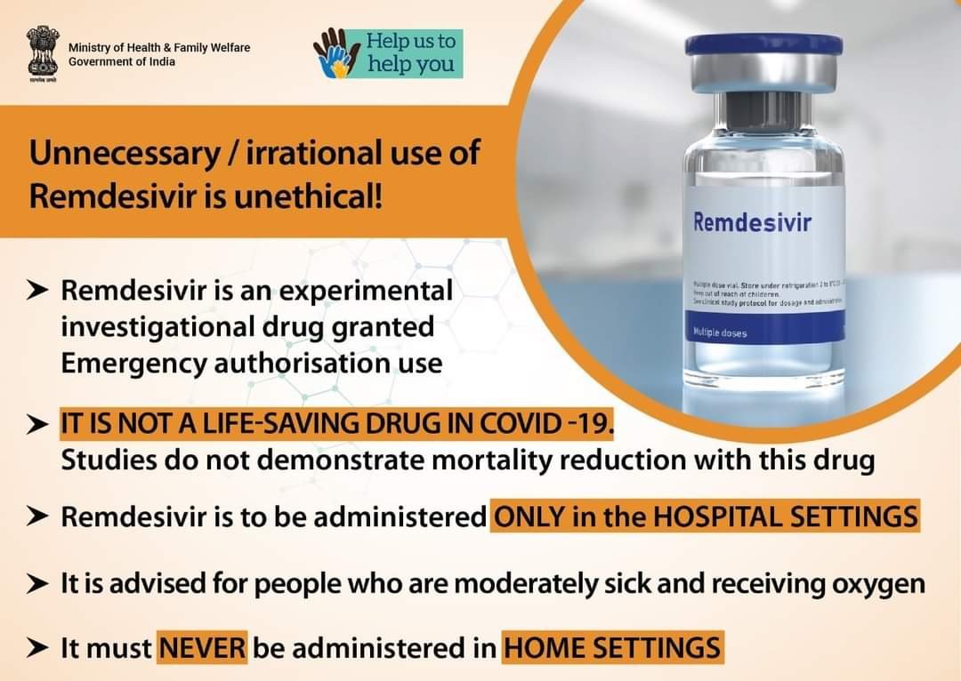

Slide 19
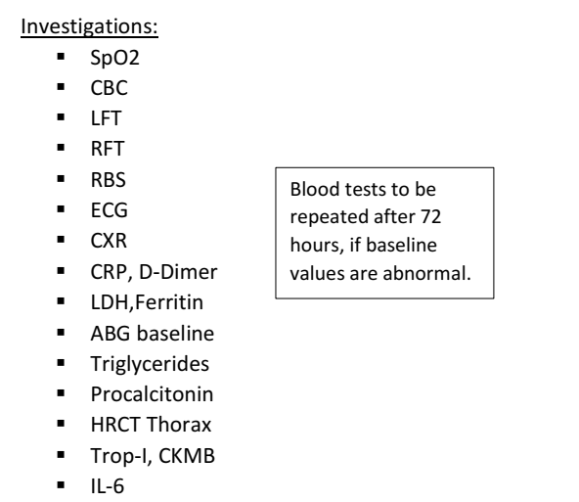
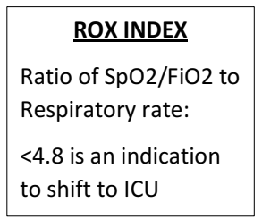
Designated COVID Hospitals (DCH)- Wards
D
Pneumonia Without Respiratory Failure
SpO2 >94%
Blood tests to be repeated after 48 hours, if baseline values are abnormal
All the decisions to be taken on the basis of Clinical Signs and Symptoms, rather than Blood and Radiological parameters.

Slide 20
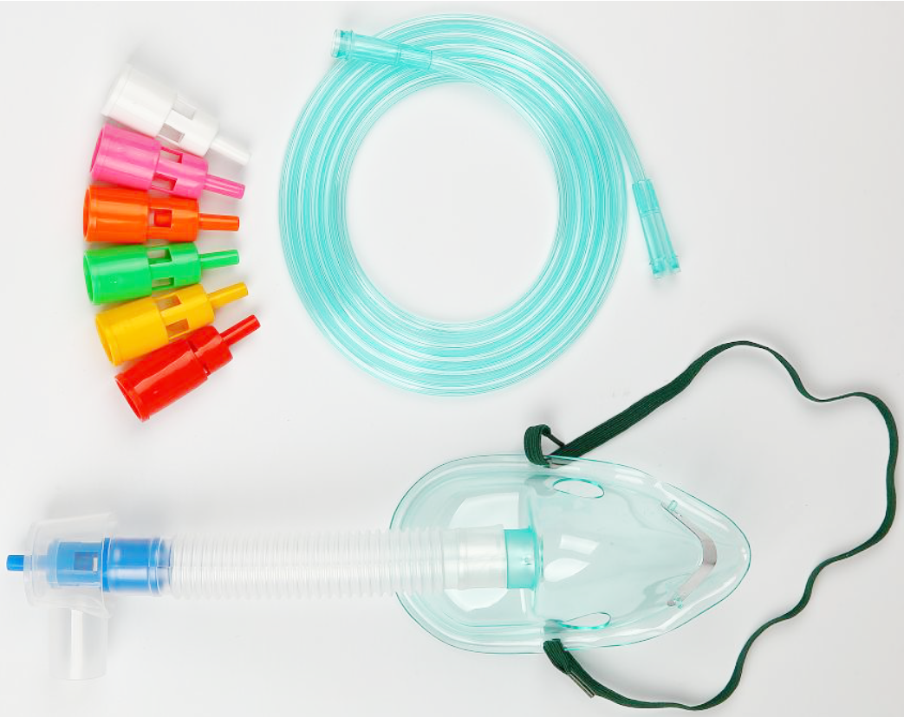
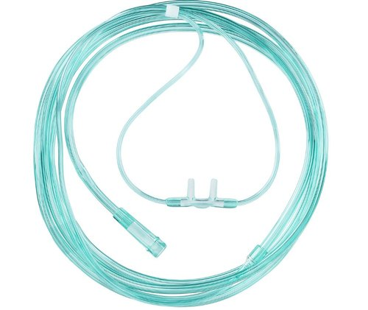
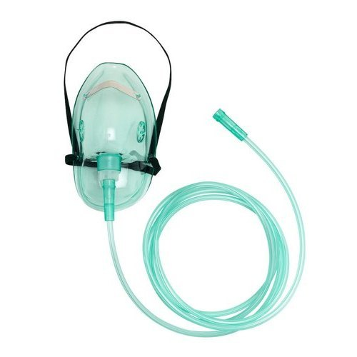
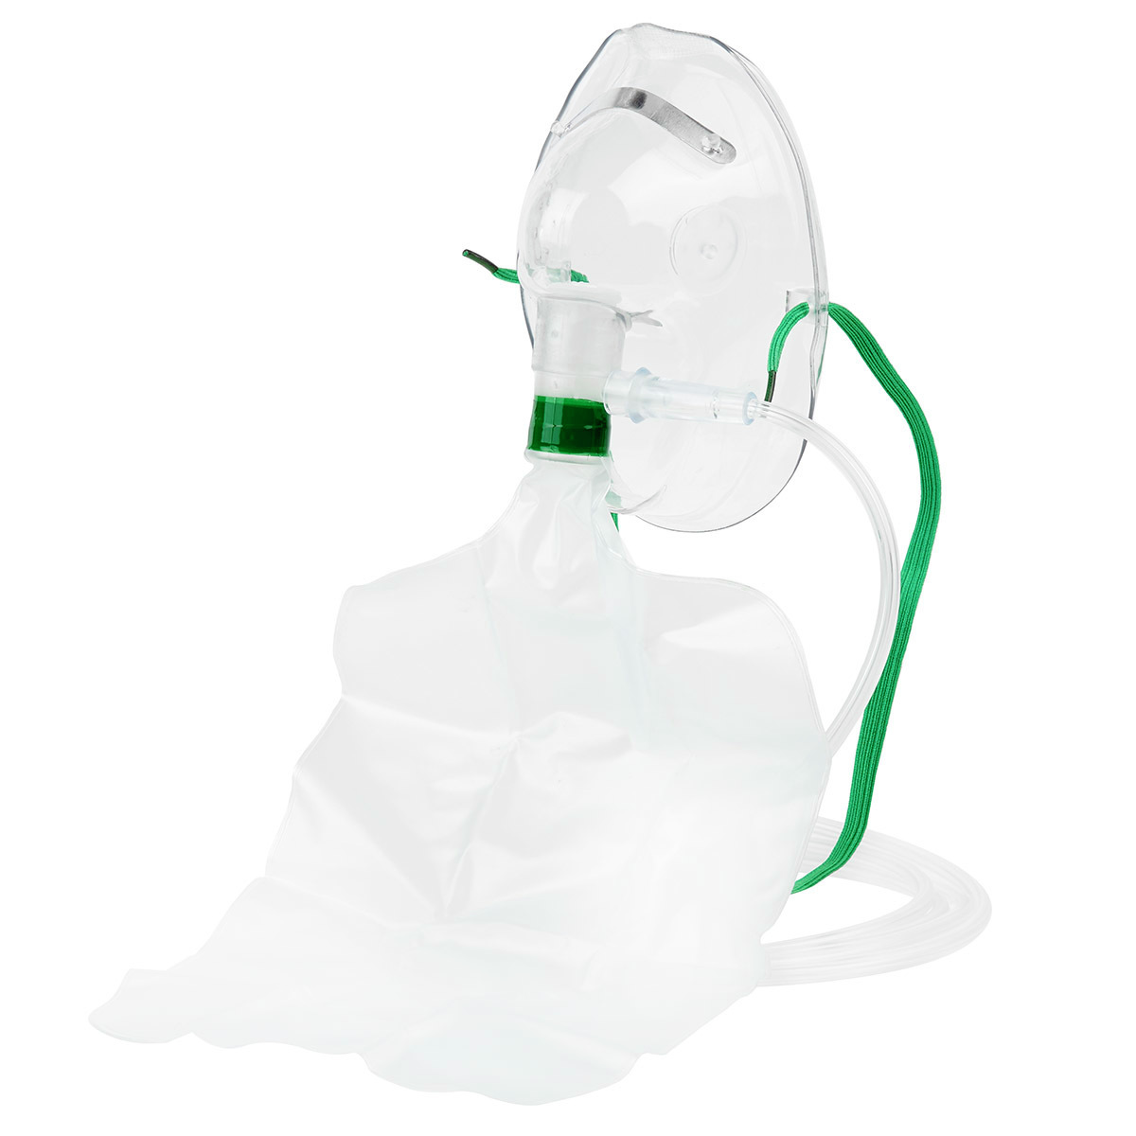
Oxygen Delivery Devices And Fio2 Range
O2 Flow Rate | FiO2 (%)
O2 Flow Rate | FiO2 (%)
Nasal cannula 1 L/min 2 3 4 5 6 | 24 28 32 36 40 44
Oxygen Mask 5-6 L/min 6-7 7-8 | 40 50 60
Venturi Mask 3 L/min 6 9 12 15 | 24 28 35 40 50
Mask with Reservoir Bag ( Partial Rebreather) 6 L/min 7 8 9 10-12 | 60 70 80 90 >99
Nonrebreathing Mask 4-15 L/min | 60-100

Slide 21
Oxygen Delivery And Titration To Be Done As Shown in the Wards :
Non-Rebreathing MASK @ 15l/m
SIMPLE FACE MASK @ 7-8 l/m
SIMPLE FACE MASK @ 5-6l/m
NASAL CANNULA 6l/m
NASAL CANNULA 2l/m
NASAL CANNULA 4l/m
Titrate oxygen up or down to maintain the target oxygen saturation
This flow chart shows available options for stepping up or down in Wards
Allow at least 5 mins at each dose before adjusting further upwards or downwards (except with Major and sudden fall in saturation – falls ≥ 3% also require clinical review)
Once the patient has adequate and stable saturation on minimal oxygen dose, consider discontinuation of oxygen therapy

Slide 22
WEANING of OXYGEN THERAPY
NIV BiPAP
TARGET SPO2: 94-96%
HFNC + iNTERMITTENT NIV
TARGET SPO2: 94-96%
(2Hrs on & 2Hrs off Oxygen)
NRBM + HFNC
TARGET SPO2: 94-96%
(2Hrs on & 2Hrs off Oxygen)
FACE MASK + NRBM
TARGET SPO2: 94-96%
(2Hrs on & 2Hrs off Oxygen)
NASAL PRONGS
TARGET SPO2: 94-96%
DISCONTINUE OXYGEN

Slide 23
Designated COVID Hospitals (DCH)- Wards
D
Management:
Inj. LMWH [E.g., Enoxaparin 0.5mg/kg/day] S/C or Inj. Heparin 5000U IV TID if D-Dimer >1000ng/ml for 7 days/ till discharge if values of D-Dimer is still high >500.
If CRP is elevated, Steroids can be Considered
Inj. Methylprednisolone 40mg IV [1-2mg/kg] for 5-10 days OR
Inj. Dexamethasone 6mg IV [0.2-0.4mg/kg]
Inj. Remdesivir 200mg IV OD on D1, F/b 100mg IV OD for 4 days
T. Vitamin C 500mg BD
T. Zinc 50mg OD

Slide 24
Designated COVID Hospitals (DCH)- Wards
D
Start on Oxygen therapy if Saturation drops <94%.
Pulmonary Rehabilitation Exercises to be initiated
Supportive Counselling of the Patient & family members
Monitor Symptoms and Body Temperature
Monitor Oxygen saturation
Adequate Control and Management of Comorbidities
Antibiotics if Clinical Signs of Bacterial Infection
Danger Signs:
SpO2 <90% on any occasion, PaO2 <60mmHg
Neutrophil Lymphocyte Ratio >17

Slide 25
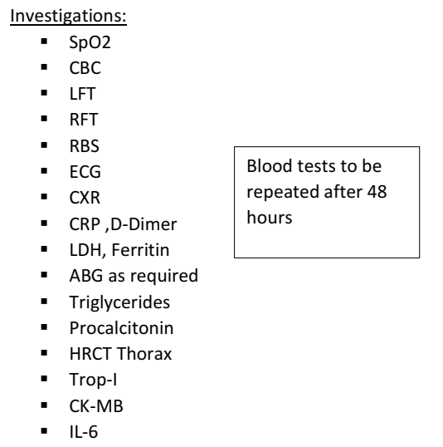

Designated COVID Hospitals (DCH)- Wards
E
Pneumonia with Respiratory Failure
SpO2 <94%
All the decisions to be taken on the basis of Clinical Signs and Symptoms, rather than Blood and Radiological parameters.

Slide 26
Designated COVID Hospitals (DCH)- Wards
E
Management:
Oxygen Therapy as Appropriate
CARP (COVID19 Awake Repositioning-Proning) Protocol
Inj. Methylprednisolone 40mg IV [1-2mg/kg] OD for 5-10 days OR
Inj. Dexamethasone 6mg IV [0.2-0.4mg/kg] OD for 5-10 days
Inj. LMWH [E.g., Enoxaparin 0.5mg/kg/day] S/C or Inj. Heparin 5000 IU IV TID till the patient is discharged/ D-dimer levels <500ng/dl
Inj. Remdesivir 200mg IV OD on D1, F/b 100mg IV OD for 4 days.
Consider Use of Convalescent Plasma Therapy, 4-13ml/kg (Usually 200ml single dose is given slowly over not less than 2 hours) if Patient continues to be hypoxic when still on Antivirals; Not recommended after 6th day of illness.
T. Vitamin C 500mg BD
T. Zinc 50mg OD

Slide 27
Designated COVID Hospitals (DCH)- Wards
E
Adequate Control and Management of Comorbidities
Antibiotics if Clinical Signs of Bacterial Infection
Pulmonary Rehabilitation Exercises to be initiated
Supportive Counselling of the Patient & family members
Danger Signs:
SpO2 <90% on any occasion, PaO2 <60mmHg
Neutrophil Lymphocyte Ratio >17

Slide 28
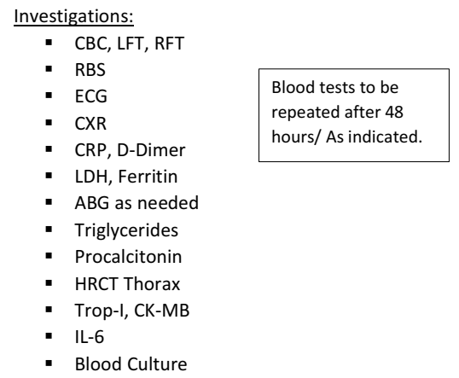
Designated COVID Hospitals (DCH)- ICU
F
Pneumonia with Respiratory Failure with Sepsis /Septic Shock/Multi Organ Dysfunction Syndrome
SpO2 <90 on Room Air
RR>30/min
PaO2 <60mmHg
Altered Mental Status
Any Sign of End Organ Damage
All the decisions to be taken on the basis of Clinical Signs and Symptoms, rather than Blood and Radiological parameters.

Slide 29
Designated COVID Hospitals (DCH)- ICU
F
Management:
Oxygen Therapy and Airway Management as Appropriate
CARP (COVID Awake Repositioning Proning) Protocol
Initiate Antibiotics as per Institution Protocol, Ideally within 1 hour of Admission.
Inj. LMWH [E.g., Enoxaparin 0.5mg/kg/day BD] S/C or Inj. Heparin 5000U IV TID until discharge.
Inj. Methylprednisolone 40mg IV BD for 5-10 days OR
Inj. Dexamethasone 6mg IV BD for up to 10 days OR
Inj. Hydrocortisone 50mg TiD for up to 10 days OR
Tab. Prednisolone 40mg OD OR
Inj/Tab. Methylprednisolone 16mg BD or 8mg QiD
Consider use of Inj. Tocilizumab 8mg/kg IV in 100ml NS over 1 hour OR
Inj. Itolizumab Up to 1.6 mg/kg IV, to be given in 250 ml normal saline over 6 hours, Single dose : If Patient continues to be hypoxic inspite of Higher Respiratory Support.
T. Vitamin C 500mg BD, T. Zinc 50mg OD

Slide 30
Designated COVID Hospitals (DCH)- ICU
F
Continuous Monitoring of Vital parameters
Adequate Control and Management of Comorbidities
Pulmonary Rehabilitation Exercises to be initiated
Supportive Counselling of family members.
Cardiac Monitoring and MR-Scanning for Myocarditis
Investigations to be repeated as and when appropriate, Decisions to be individualised to each patient

Slide 31
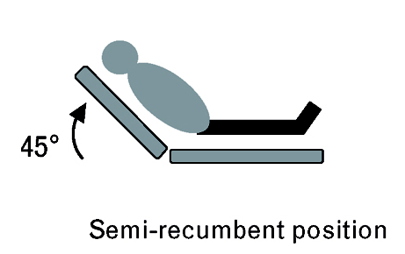
VENTILLATION IN PATIENTS WITH ARDS WITH NEAR-NORMAL LUNG COMPLIANCE: (L Type)
Select volume A/C mode on the ventilator
Tidal volume - 8-10 ml/kg
PEEP <10 cms of water with BP monitoring
FIO2 < 60 - 70% to keep SaO2 > 85, PaO2 < 60 mmhg
Prone ventilation not indicated
Try semi recumbent position
Try weaning slowly, watch for mucosal oedema, Hydrocortisone 200 mg IV, 30min before extubating.
All the decisions to be on the basis of Clinical Signs and Symptoms , rather than Blood and Radiological parameters.

Slide 32
VENTILLATION IN PATIENTS WITH ARDS WITH LOW LUNG COMPLIANCE: (H Type )
Select volume A/C mode on the ventilator
Set ventilator settings to achieve initial VT = 6 mL/kg body weight.
VT for a 60kg Person : 6*60 =360mL
PEEP to be set at higher value than normal, to titrate up.
Set initial Respiratory rate to around 20bpm,
titrate so as to approximate baseline minute ventilation (not >35 bpm).
Check P-plat at least every 4 hours and after each change in PEEP or VT
Plateau Pressure to be measured by Inspiratory Pause on the Ventilator
Plateau pressure goal: ≤30 cm H2O
If the Pplat remains above 30 cm H2O, decrease VT by 1 mL/kg steps (minimum = 4 mL/kg).
Aim for a pH over 7.2, do not worry about the PaCO2. If the PaCO2 keeps going up too much in spite of a RR of 35, If the pH drops below 7.2, consider adding sodium bicarbonate infusion.

Slide 33
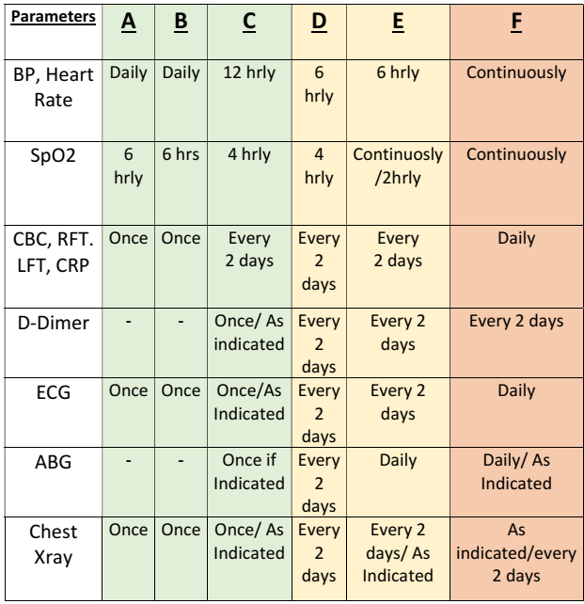
Monitoring :

Slide 34
CARP PROTOCOL
To change Position between the following every 2 hours :
Left Lateral Recumbent
Right Lateral Recumbent
Sitting upright 60-90 degree
Lying Prone in bed
&
Trendelenburg [Supine, Bed 30degree head down]
(only If above 4 positions don’t show improvement )
Check Saturation after 10 mins of position change, if it has not improved, change to different position.

Slide 35
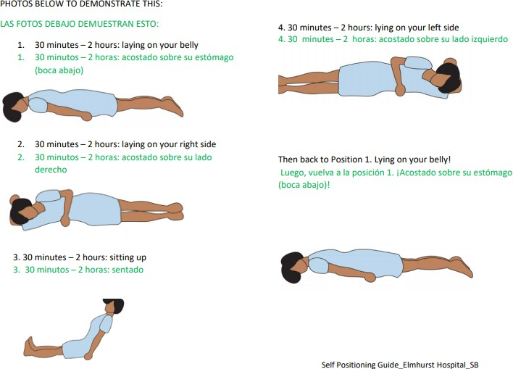

Slide 36
OXYGEN THERAPY TITRATION
Face Mask Up to 12L/min
Non Rebreathing Mask up to 15L/min
High Flow Nasal Canula
Non Invasive Ventilator
Invasive Mechanical Ventilator
Nasal Canula Up to 6L/min
TARGET SATURATION
(with lowest FiO2 possible)
All COVID19 patients : SpO2 94-96%
COVID19 patients with COPD :SpO2 88-92%
For Patients on Mechanical Ventilation: SpO2 90-92%
Allow at least 5 mins at each dose before adjusting further upwards or downwards (except with Major and sudden fall in saturation – falls ≥ 3% also require clinical review)

Slide 37
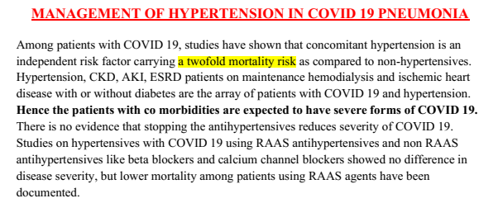
Hypertension

Slide 38
Investigations recommended for hypertensives with COVID 19: • ECG/ 2D ECHO is possible • BNP, Troponin I, CPK-MB • RFT/urine routine • Serum electrolytes • Cardiac monitoring for arrhythmias • USG abdomen/chest • MR scanning for myocarditis.

Slide 39
All COVID 19 patients presenting with hypertension BP>140/90, / SBP>160 mmHg 1. With history of hypertensive drugs for same- to continue, if well controlled. 2. Diabetics if on ACE inhibitors or ARBs to continue. 3. CKD/ESRD on HD - to continue same antihypertensives closely monitoring RFT and serum electrolytes/ RRT continued. 4. If AKI suspected-
urine routine for proteinuria, hematuria, abnormal RFT.
• Monitor input/output chart • Avoid ACE inhibitors and ARBs. Use non RAAS antihypertensives. • Daily monitoring of serum creatinine and serum electrolytes. • Avoid nephrotoxic drugs. • If associated diabetes mellitus present or steroid used for ARDS COVID 19 regimen, monitor blood sugars • Check for procalcitonin

Slide 40
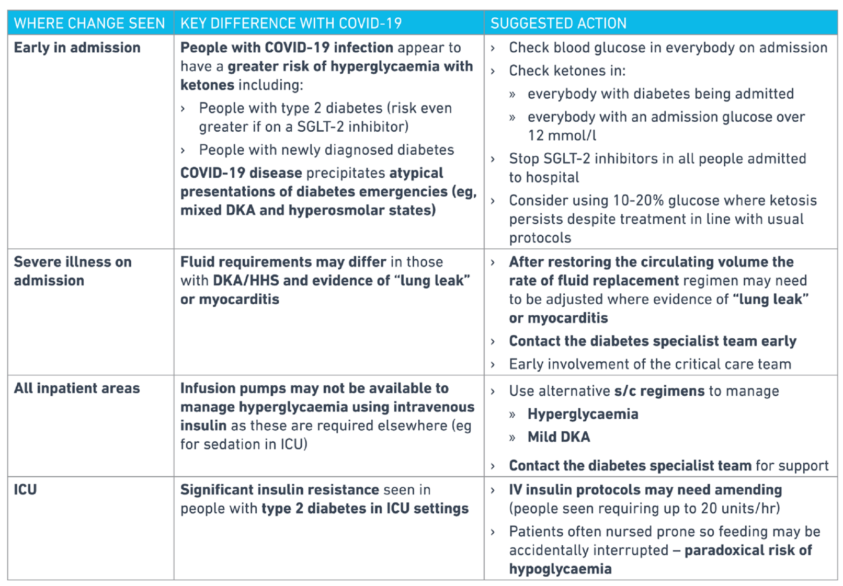

Slide 41
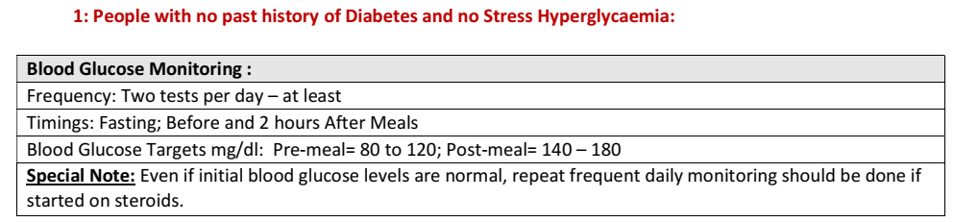

Slide 42
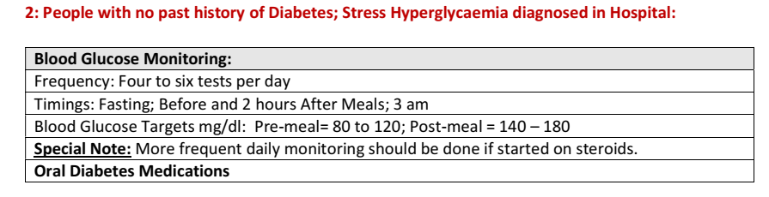
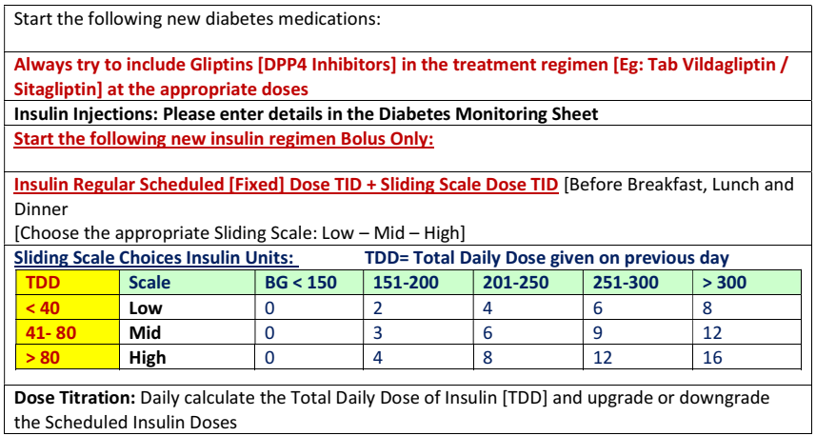

Slide 43
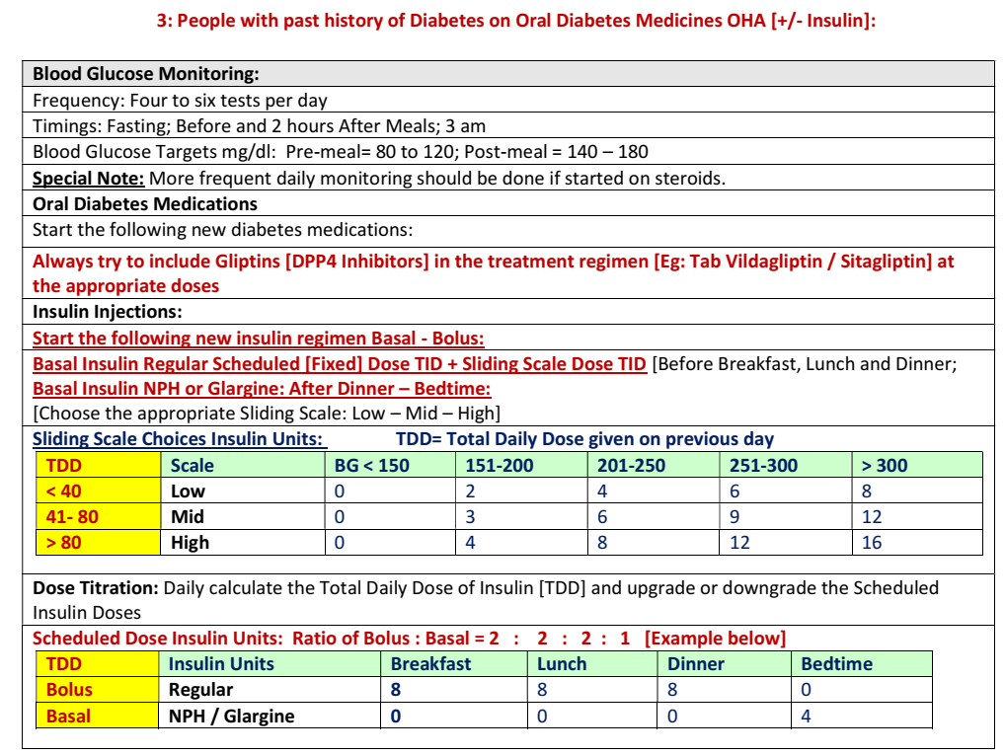

Slide 44
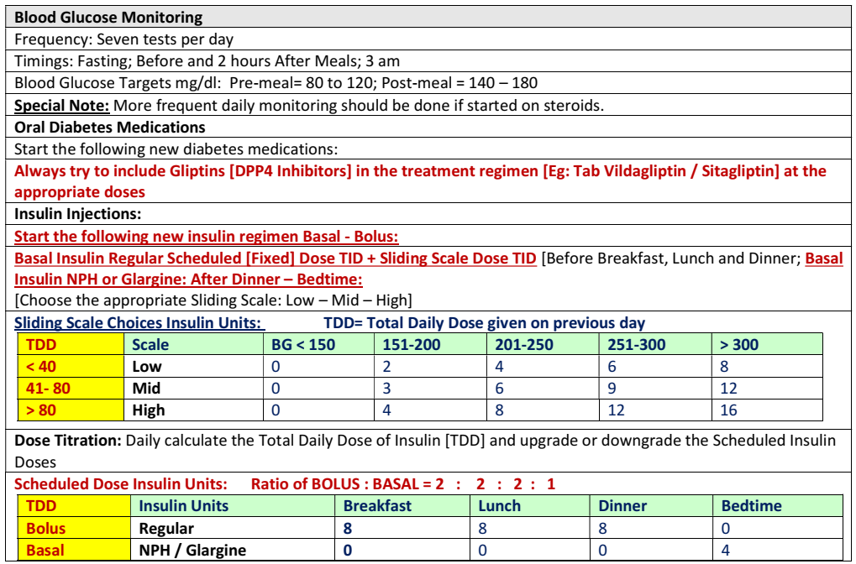

Slide 45
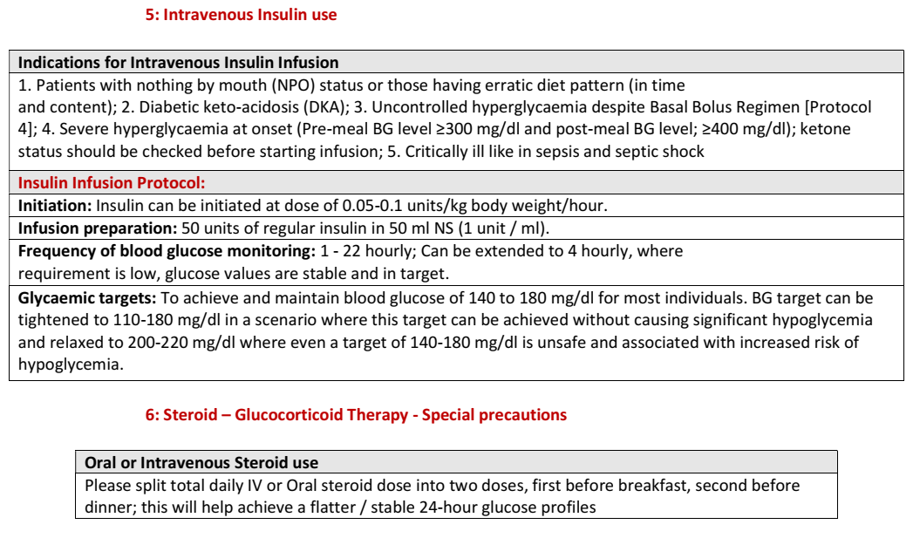

Slide 46
THANK YOU

Slide 47
Death due to COVID19
Definition of deaths due to COVID 19
▪ A death due to COVID-19 is defined for surveillance purposes as a death resulting from a clinically compatible illness, in a probable or confirmed COVID-19 case, unless there is a clear alternative cause of death that cannot be related to COVID disease (e.g. trauma). There should be no period of complete recovery from COVID-19 between illness and death.
▪ A death due to COVID-19 may not be attributed to another disease (e.g. cancer) and should be counted independently of pre-existing conditions that are suspected of triggering a severe course of COVID-19.
▪ Deaths due to COVID-19 are the ones that are counted in cause of death data collection (for the purposes of COVID-19 death reporting).

Slide 48
Definition of death due to COVID-19 (by WHO)
A COVID-19 death is defined for surveillance purposes as a death resulting from a clinically compatible illness in a probable or confirmed COVID-19 case, unless there is a clear alternative cause of death that cannot be related to COVID-19 disease (e.g. trauma). There should be no period of complete recovery between the illness and death.
Reporting in case of death of such patients
Use ICD-10 Codes for COVID-19 provided by World Health Organization
Emergency ICD-10 Code Usage conditions
U07.1: COVID-19,virus identified
U07.2: COVID-19, virus not identified: Clinically-epidemiologically diagnosed COVID-19, Probable COVID-19, Suspected COVID-19
To dispose the dead body in a dignified manner with similar protocol as for COVID19 positive case (Refer to Latest GoK Guidelines)

